Slide 1

Mapping the pokemon tcg leaderboard
Daniel Hing
Notes:
Hi, this is my project to map Play Pokemon Trading Card Game Leaderboard

Slide 2



Goals
To build an interactable map upon which visualizes the data of the top 500 players on the Championship Leaderboard presented by pokemon.com for the Pokémon Trading Card Game (to see which countries are the very best that no one ever was)
Notes:
Starting with what goals I had for this project. To build an interactable map which visualizes the data that the Championship Leaderboard presented by pokemon.com for the Pokemon Trading Card Game, (to see which countries are the very best that no one ever was)

Slide 3
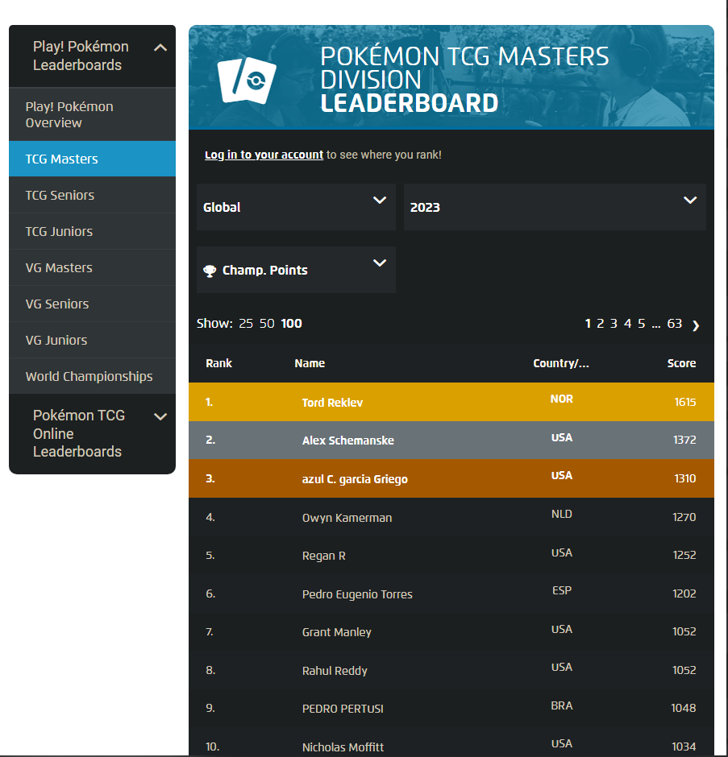

INTRODUCTION
Pokemon handles 4 major tournaments in a year
LAIC
OCIC
EUIC
NAIC
Resulting in the World Championships
The Play!Pokemon Leaderboard provided on pokemon.com
Notes:
Pokemon provides several levels of competition across its games. Similarly to Tennis or Golf a points style accrual of points happen across a season, at 4 major tournaments with minor events occurring between them. Culminating in an invite to the final major event in the year (The World Championships) if performance is strong enough by the end of the season.
To monitor performance of top level players Pokemon provides a leaderboard that provides continually updating snapshots of points earned.
I wanted to create a map based on the pokemon Trading Card Game Masters Leaderboard, one that shows the performance levels of each country as a whole

Slide 4

Data Acquisition
Notes:
So my first section is a quick dive into the method of how I acquired the data required for my project.

Slide 5

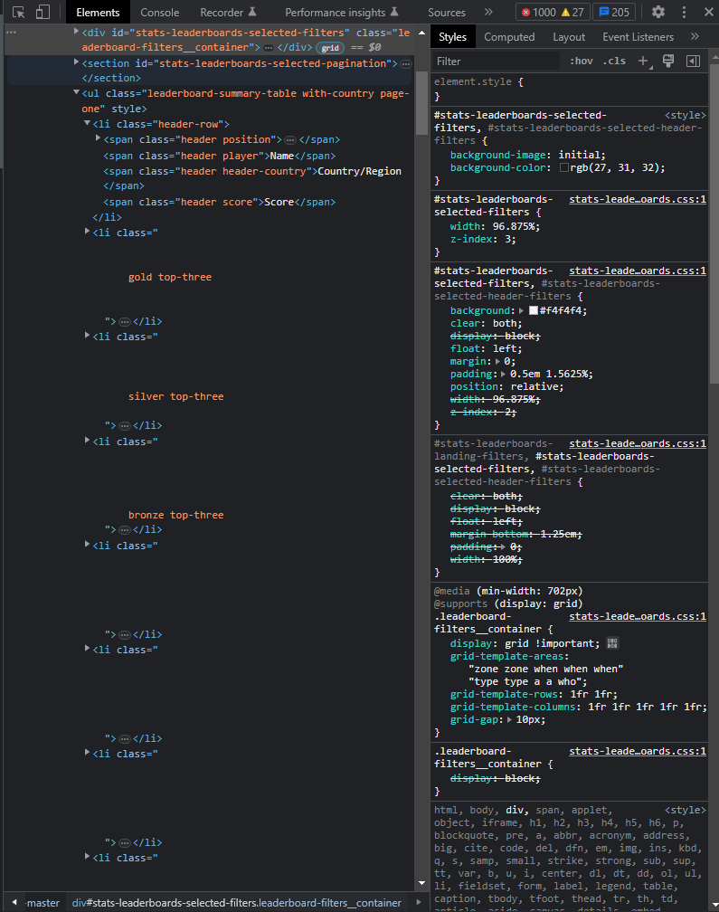
Building a database: Inspecting Data
Used to get name/score/country data
https://www.pokemon.com/us/play-pokemon/leaderboards/tcg-masters/
Python
Use splinter to navigate the HTML
Copy relevant elements into a local HTML
Player Name
Score
Country name/Code
Sourced the top 500 players
2023 as of current
2020 as of end of season
Missing Data for visualization
Coordinates
Notes:
Pokemon provides a public facing leaderboard at https://www.pokemon.com/us/play-pokemon/leaderboards/tcg-masters/
To acquire this data I utilized python to learn about the structure of the html. Once I learnt about the structure of the data I moved the html into added it to my resources. The usable data was a player name, a score and a country name/country code the player comes from.
Notably this did not provide coordinates to each country’s location and so will have to find said data from another source

Slide 6
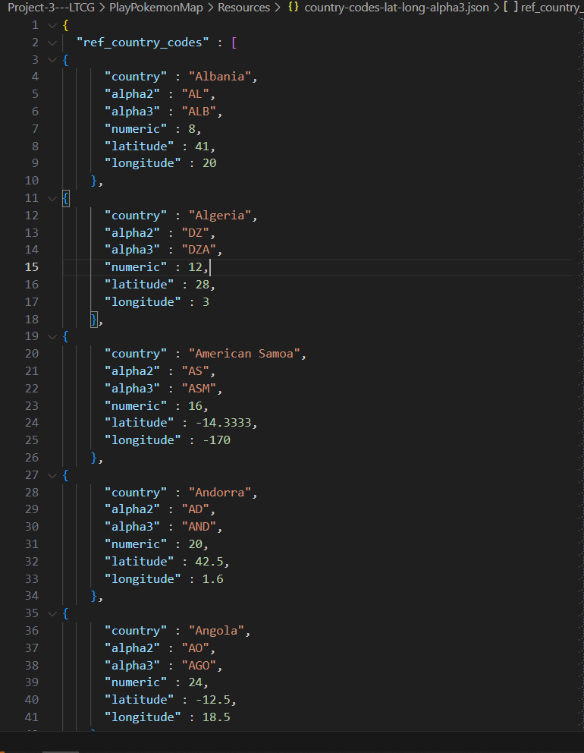

Building a database: Acquiring latitude and longitude
https://gist.github.com/tadast/8827699
CSV
Alpha 3 Codes
Latitude
Longitude
Convert to json
Python
Pair lat/lon on country codes
Set variables
Country
Player Count
Score
Coords
Notes:
I used tadast’s countries_codes_and_coordinates found on github which provided a CSV which included Alpha-3 codes, latitude and longitude in its’ data. I converted the document to a json then in python paired the latitude and longitude coordinates with the Pokémon league table data. Then for each country in the list I set empty values for player count and score.

Slide 7
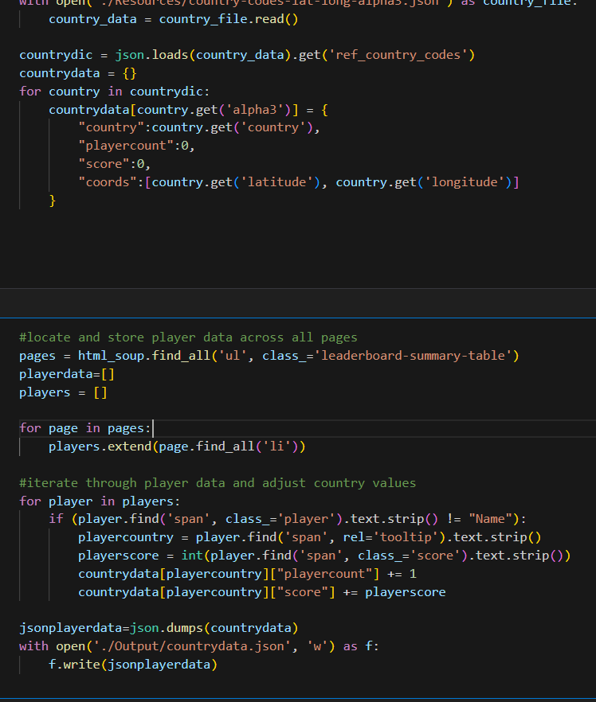

Building a database: Recording Values
Python
Country/Cooordinate data
Player data
Score
Player Count
Write to Json
Notes:
Then it’s a simle matter of taking the updated country and coordinate data and iterating through the player data, storing new values for player count and score and then output them to a json

Slide 8
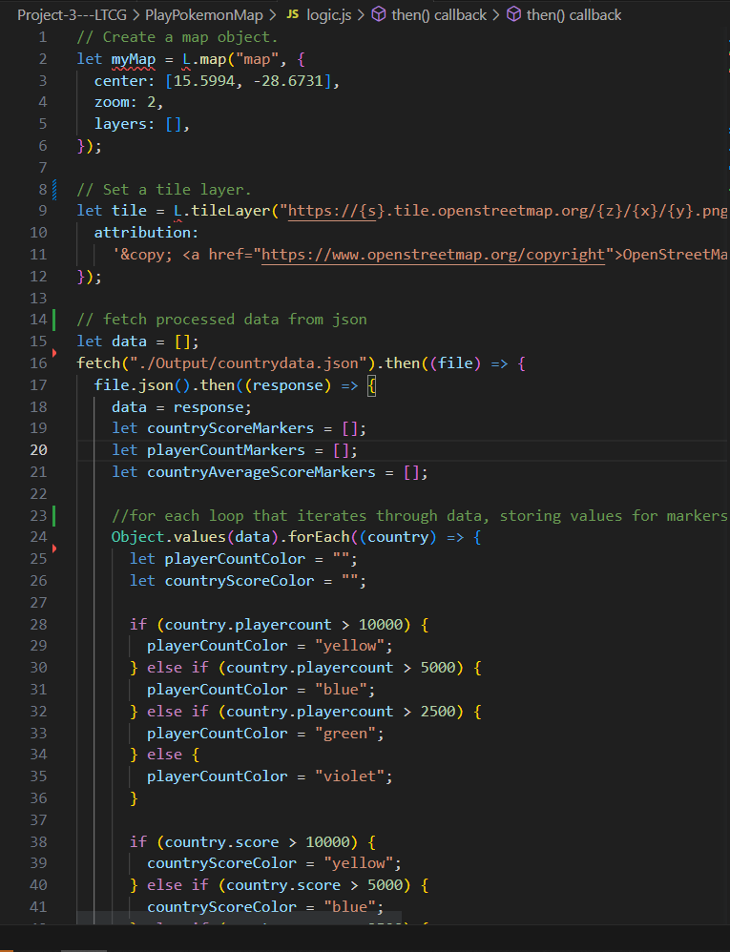

Building a Map
Javascript
Leaflet
Lists
Country Score
PlayerCount
countryAverage
Loop through data
Marker group creation
Based on values
Relevant Popup
Create Overlay Layers
Use markergroups
Create layers for each
Notes:
Using JavaScript and the leaflet library I iterated through the newly built database to build different marker groups representing a country’s total championship points, player count and the average performance of a player.
With those marker groups I created layers that separated “Player Count”, “Total Country Score” and “Average Player Score”
I then created a map that utilised these different stored values to create map visualisations that were independently viewable.

Slide 9
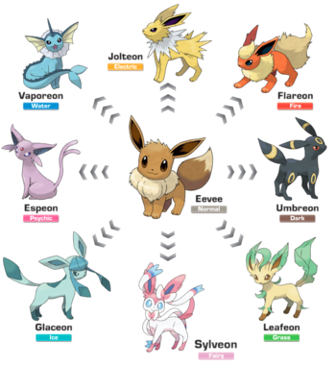
Output
Notes:
So let’s look at what all our data finally evolved into!

Slide 10
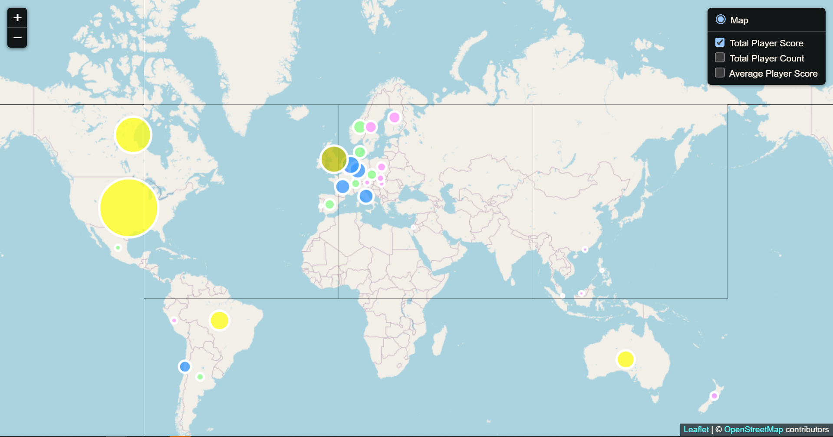
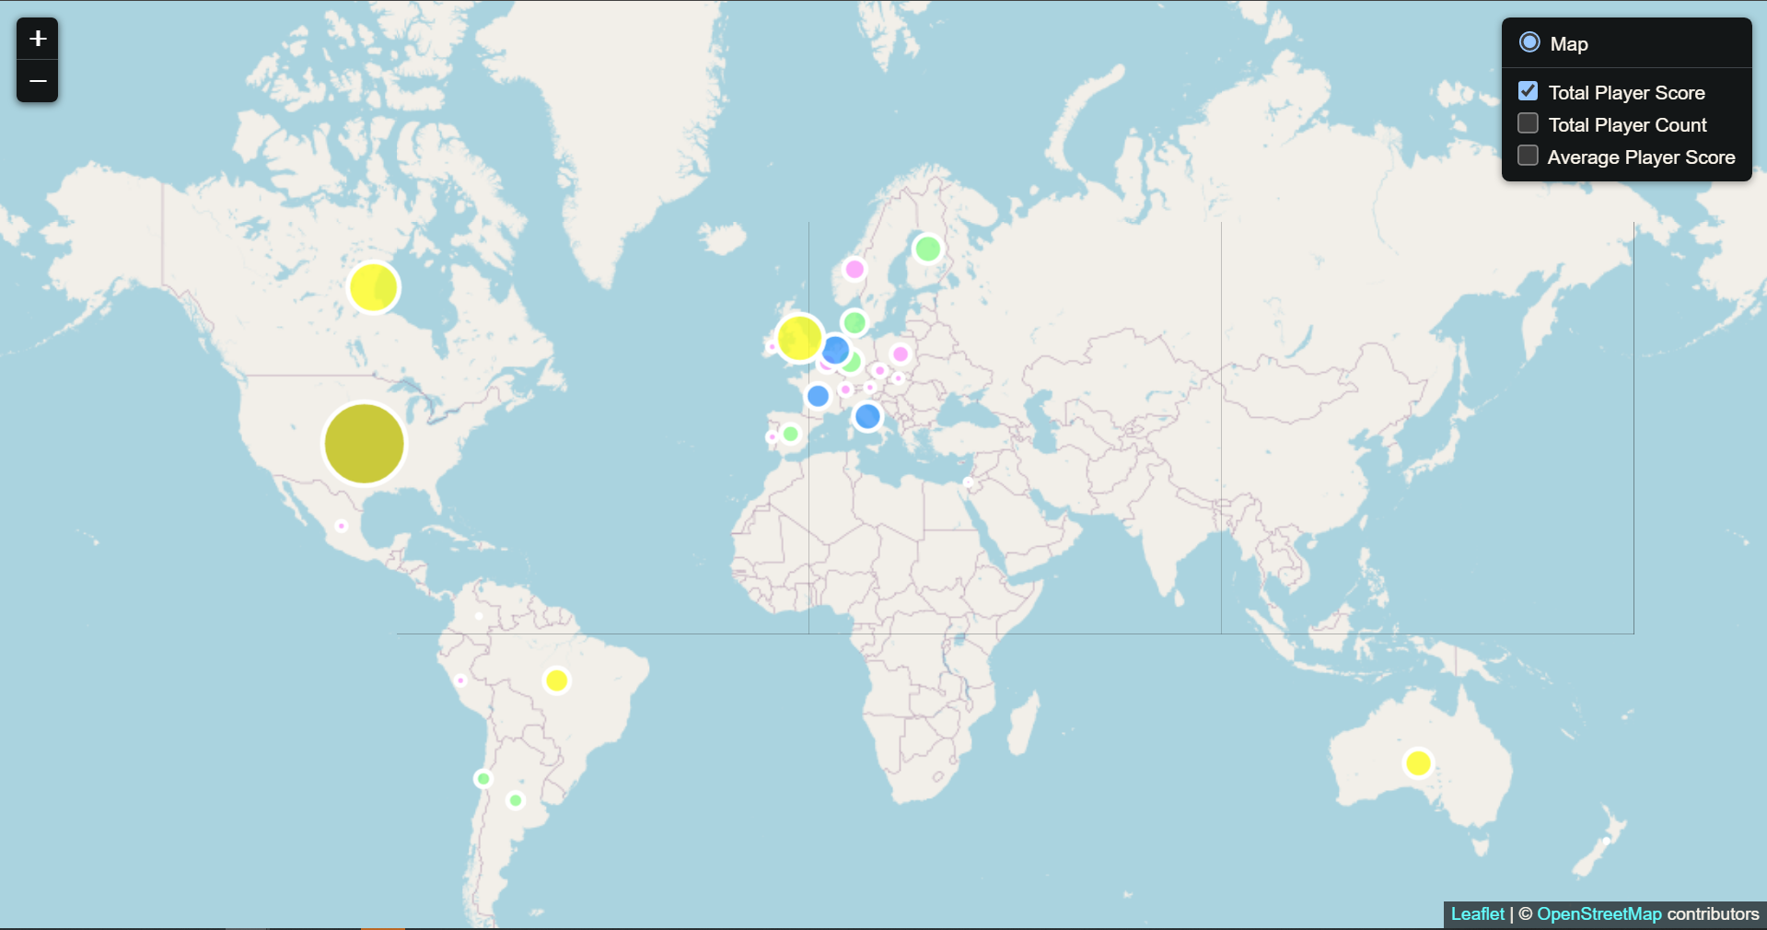
Output for total Player Scores
Output for Player Score in 2020
Output for Player Score in 2023
Major championship point distributing events – LAIC, OCIC, EUIC, NAIC
NAIC due for 30/06/23 – 2/07/23
Notable absences
Japan
China
Notes:
The visualization of Total Player Score in the pre covid era vs post covid era doesn’t show significant differences
It’s worth noting that there are geographical correlations between the 4 major point giving events (Latin American International Championships (Brazil), Oceanic International Championships (Australia), European International Championships (EU) and North American International Championships(USA)) and countries with higher score totals.
Total player score in 2020 map is higher due to one major event (NAIC) has yet to occur, set to be held on June 30th of this year, so those points haven’t been distributed into the league ecosystem.
There are some noticeable absences on the map, which are very easy to see visually when laid out like this. Those of Japan and China despite having very strong pokemon fanbases are absent on the leaderboard.
Japan-Home of pokemon. They participate in the final major event of the year (the world championships) but their qualification route for Worlds does not go through the Play Pokemon league that the other countries participate in. They have their own weekly and quarterly events known as City Championships, and so do not feature on the leaderboard.
China-Pokemon as a TCG was only recently introduced to mainland China. This has resulted in China being a few years behind the rest of the world’s distribution as they push through sets to catch up before they can participate in global events. Notably Hong Kong and Taiwan do participate in events but have their own qualification system for Worlds, similar to Japan. It is worth noting that those players do occasionally choose to participate in the international circuit (hence the blip in 2020).

Slide 11
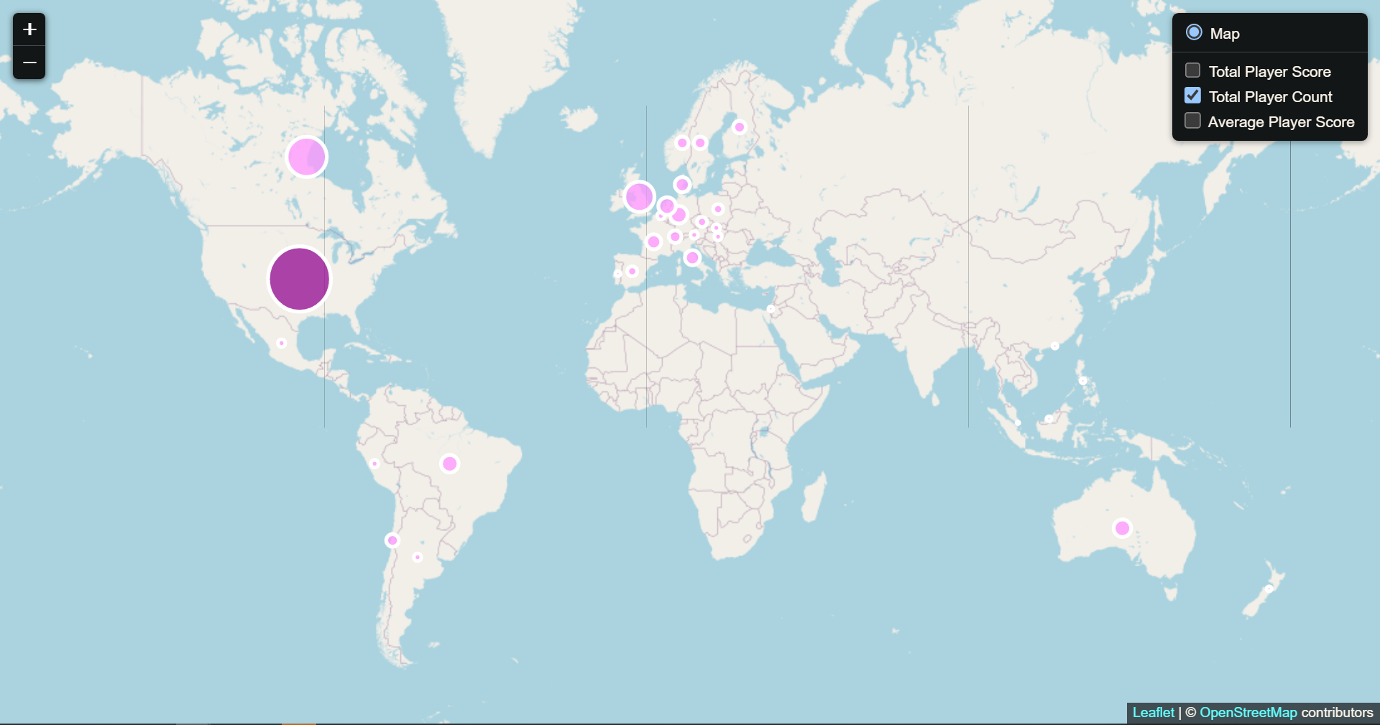
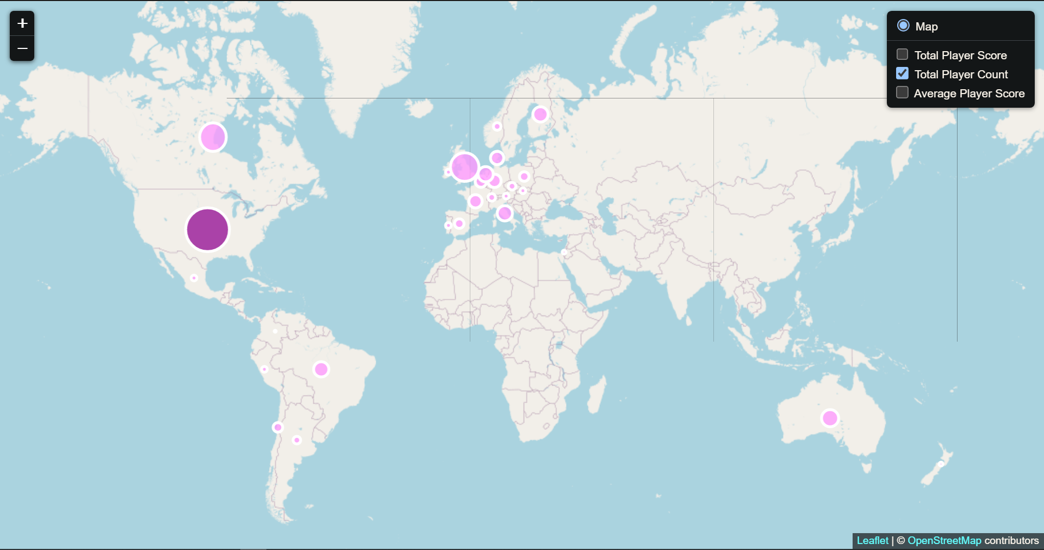
Output for Country Player Count in top 500
Output for Player Count ins 2020
Output for Player Count in 2023
Exceptions
Berlin/London EUIC 2020/2023
LatAm and Oceania
Smallest of the 4 major regions
Economic or Demographic causes
Notes:
It is worth noting that while the wider geographical location of host countries seems to correlate to players counts, the effect is only a trend not a rule. For example between the two sample sets, 2020’s EUIC was hosted in Berlin, Germany, whereas 2023’s was hosted in London, UK. In 2020 11 players from Germany made the top 500 whereas in 2023 13 players from Germany made the worldwide top 500.
Between 2020 and 2023 the top 500 mostly consisted of players from the same countries.
Of the 4 regions, Latin America and Australia have the smallest representation. I think this is due to the cost of travel and relative wealth for Latin American countries. To receive travel stipends and subsidies to attend the next major event from Pokemon, they need to perform at a high level at each tournament (one tournament result leads into subsidies for the next), whereas the number of players in Europe and North America that can afford travel out of pocket is higher. For Australia we have outsized representation in the hobby despite our small population, an example of how various factors can influence results.

Slide 12
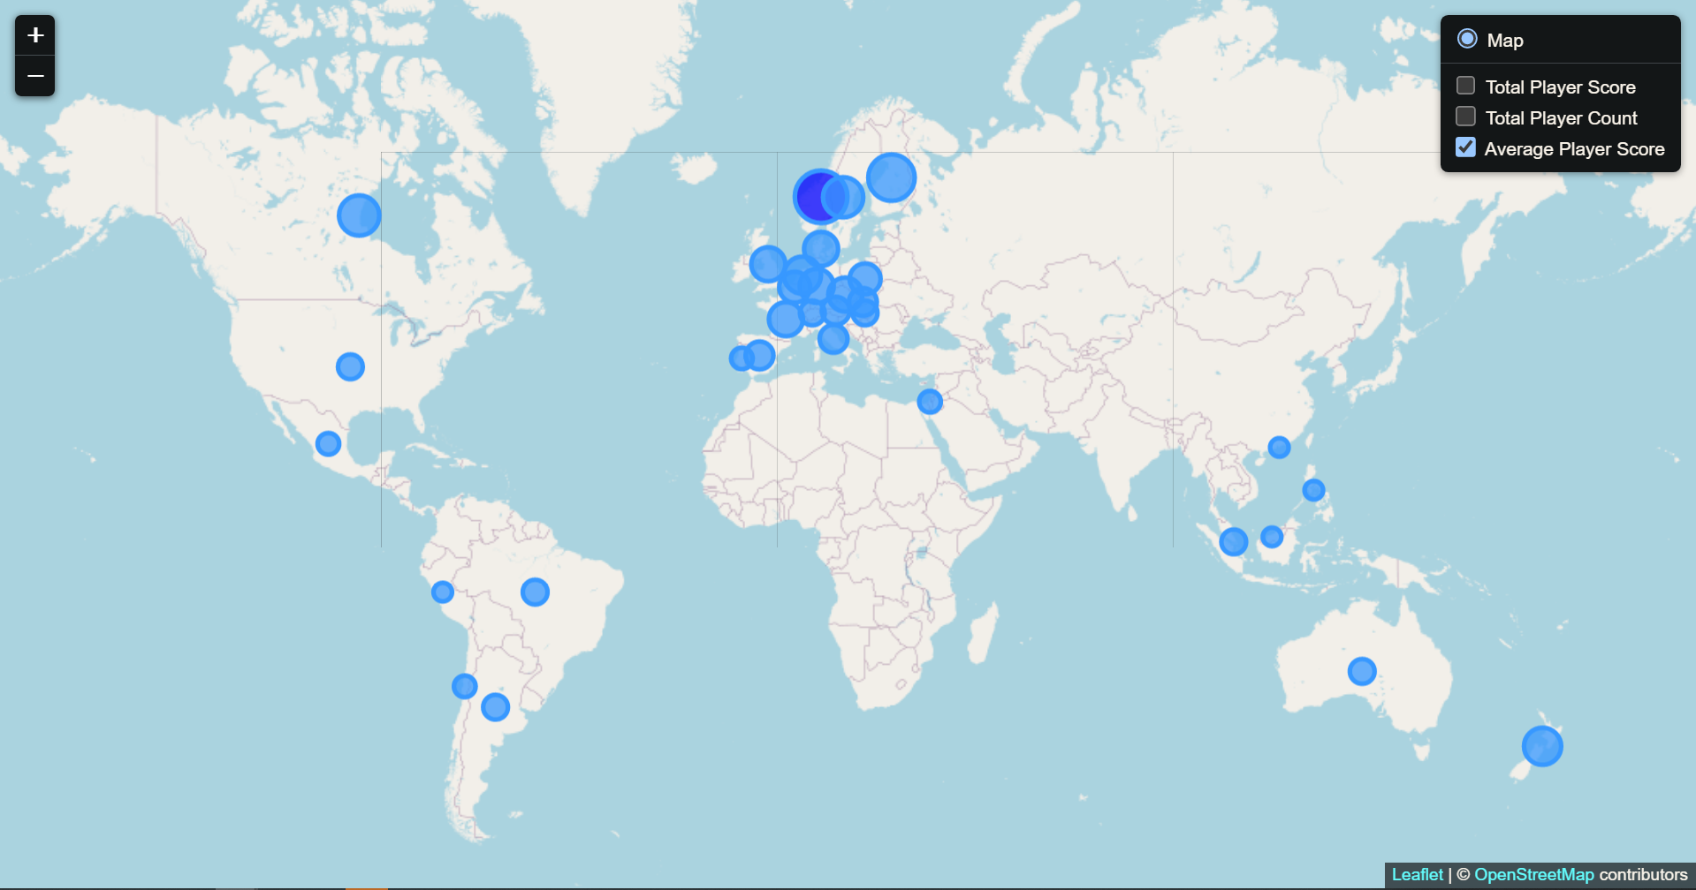
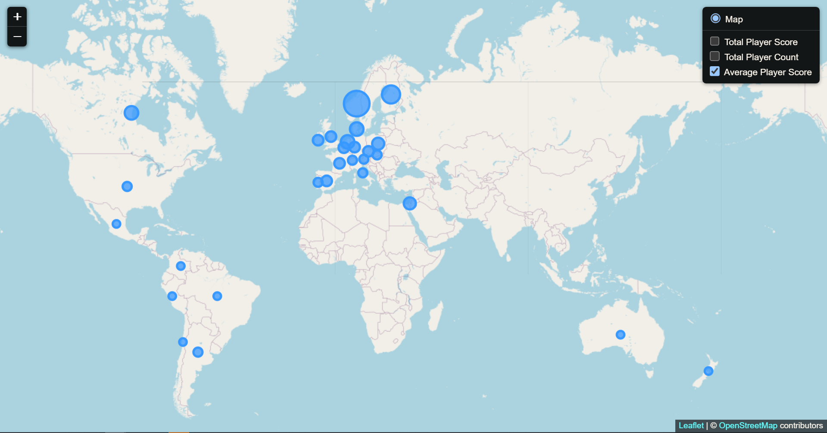
Output for Average Player Score
Output for Average Player Score in 2020
Output for Average Player Score in 2023
Differences to previous data visualizations
Outliers
Norway
Lack of SEA
Notes:
Output for average player score paints a different picture to the other 2 relatively similar data sets. With this we can see that performance across the world is less varied. The outlier and best performing country is Norway. This is due to the player count in the top 500 being very low, but those players being among the highest ranking (ie Tord Reklov current rank 1).
It’s also very clear now that SEA has been removed as a region from the circuit. This is due to Pokemon introducing a separate league/circuit for the region in the years between the two visualizations, removing them from the leaderboards.

Slide 13

Relevance Discussion of study
Conclusions
Visualisations
Demonstrate changes
User access
Changes
Moving data to single database and map
Including more series based data (time)
Changing the end user
Rather than countries/player performance data
Data that would be useful to event hosts
Notes:
In conclusion, despite the relatively frivolous nature of the project, I demonstrated that good usage of visualisations can allow users to quickly identify and demonstrate differences and changes in data. Through use of visual data we could identify patterns and the presence or lack thereof of map activity had real world causes.
Given time this project could take on a number of improvements or adaptations.
The final visualisation output could be put into a single map with drop downs for not only 2020 and 2023 but all the snapshots shown on the Pokémon League website.
My focused user for my project was competitive players. Hence the data pulled was based on top 500 players and the metrics competitive players care about. If I were to change the focus to event hosts/TPC the data set may care less about the top performing player and more about total players. Regional information about total player counts not limited to the top 500 could provide valuable information regarding booking event locations and finding suitable cities and travel hubs to host the event.

Slide 14

Bibliography
Play! Pokemon Leaderboards<https://www.pokemon.com/us/play-pokemon/leaderboards/tcg-masters/>
User Tadast’s Country Database<https://gist.github.com/tadast/8827699/>

Slide 15

THANK YOU
Notes:
Thank you for (mandatorily) attending our presentation!

